Slide 1

Automotive
Automotive in general
Functional Safety (ISO 26262)
V-Cycle

Slide 2
Automotive Acronyms
ECU : Electronic Control Unit
OEM : Original Equipment Manufacturer
AES : Automotive Embedded Software
CAN : Controller Area Network
BTS : Bureau of Transportation Statistics
ISO : International Organization for Standardization
ASIL: Automotive Safety Integrity Level framework
HARA : Hazard Analysis and Risk Assessment
ABS : Anti-Breaking System

Slide 3

Automotive – Auto:Self + Motive:Motion
Differences are made in user experience, autonomous, electric, safety, connectivity rather than traditional vehicle hardware
Automotive embedded software is critical for creating the mobility experience of the future.
Real-time complex interactions across multiple systems : Braking, steering, suspension etc. Each ECU is part of a bigger and complex electrical architecture, sometimes more than 20 interactions in AES apps

Slide 4

Automotive Industry
6th largest economy
Design – Development – Manufacturing – Repairing of Motor Vehicles
Components: Engines, bodies and not tires, batteries and fuel
Product: Passenger automobiles and light trucks
Secondary : Commerical vehicles ( semis , delivery trucks etc. )

Slide 5
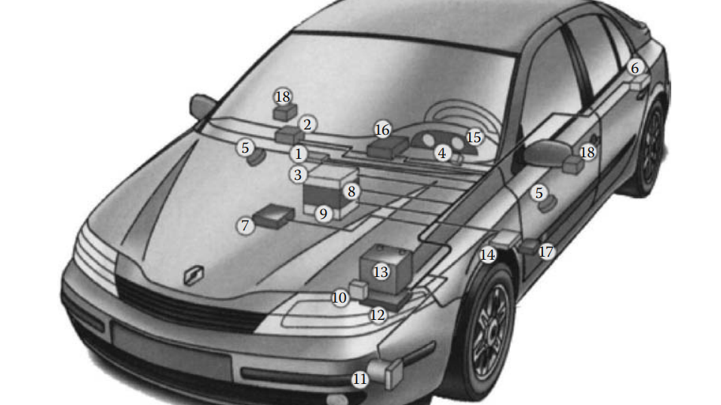
More than 10000 electrical devices and 61 micro-processors
Three controller area networks ( CAN )
Several subnetworks
Renault Laguna

Slide 6

Functional Safety
Automotive functional safety is :
Implementation of protective measures to eliminate or mitigate hazards
Hazards: caused by failure or unintended behavior of vehicle-level system
Safety goals are more critical than the functionality of the automotive component
With huge number of ECUs, sensors, actuators, the need to ensure functional safety at every stage of product development and commission has become even more important

Slide 7
ISO 26262
ISO 26262 standard defines functional safety as the “absence of unreasonable risk due to hazards caused by malfunctioning behavior of electrical/electronic systems”
Reason for standard :
Establish various safety requirements -> mitigate risks to acceptable levels
Smoothly manage and track safety requirements
Ensure standard safety procedures in delivered products
ASIL (Automotive safety integrity level) : "risk classification scheme for defining the safety requirements"
Risk parameters : Severity, Exposure and Controllability

Slide 8
Risk Parameters
Exposure ( E ) : Measure of possibilities of the vehicle being in a hazard or risky situation
E1 – very low probability
E2 .. E3..
E4 - very high probability
Controllability ( C ) : Extent to which control can be established after safety goal breached due to failure or malfunction
C1 – easy; C2..; C3.. ; C4 – most difficult to control
Severity ( S ) : Seriousness of the damage to life of people and property due to safety goal infringement
S1 – light injury, S2 severe and life threatening, S3 life threatening incidences

Slide 9
ASIL levels:
Classified from D – Highest level of automotive hazard, A – lowest.
QM ( Quality Management level ) Therefore hazards that do not dictate safety requirements
ASIL - A
ASIL - B
ASIL - C
ASIL - D

Slide 10
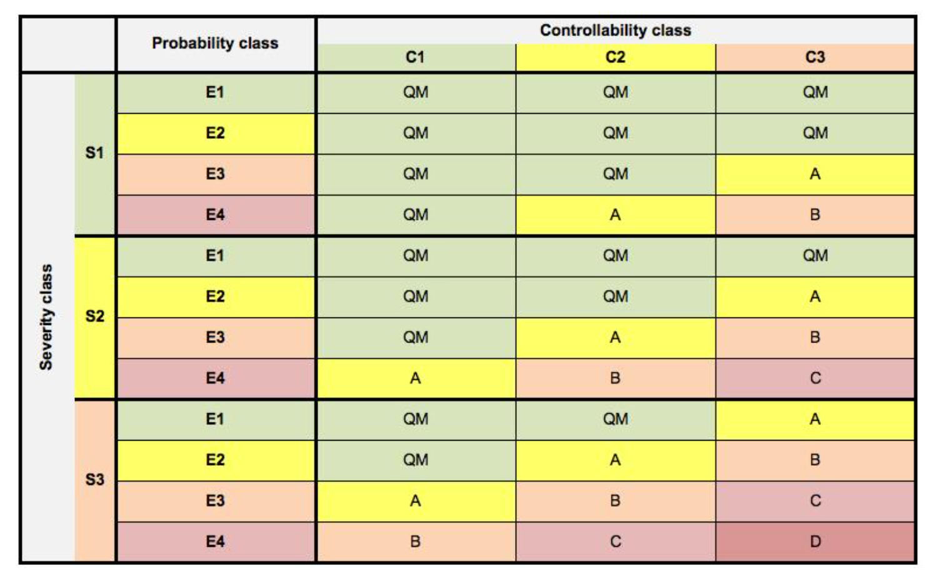
Image credit: techdesignforums

Slide 11
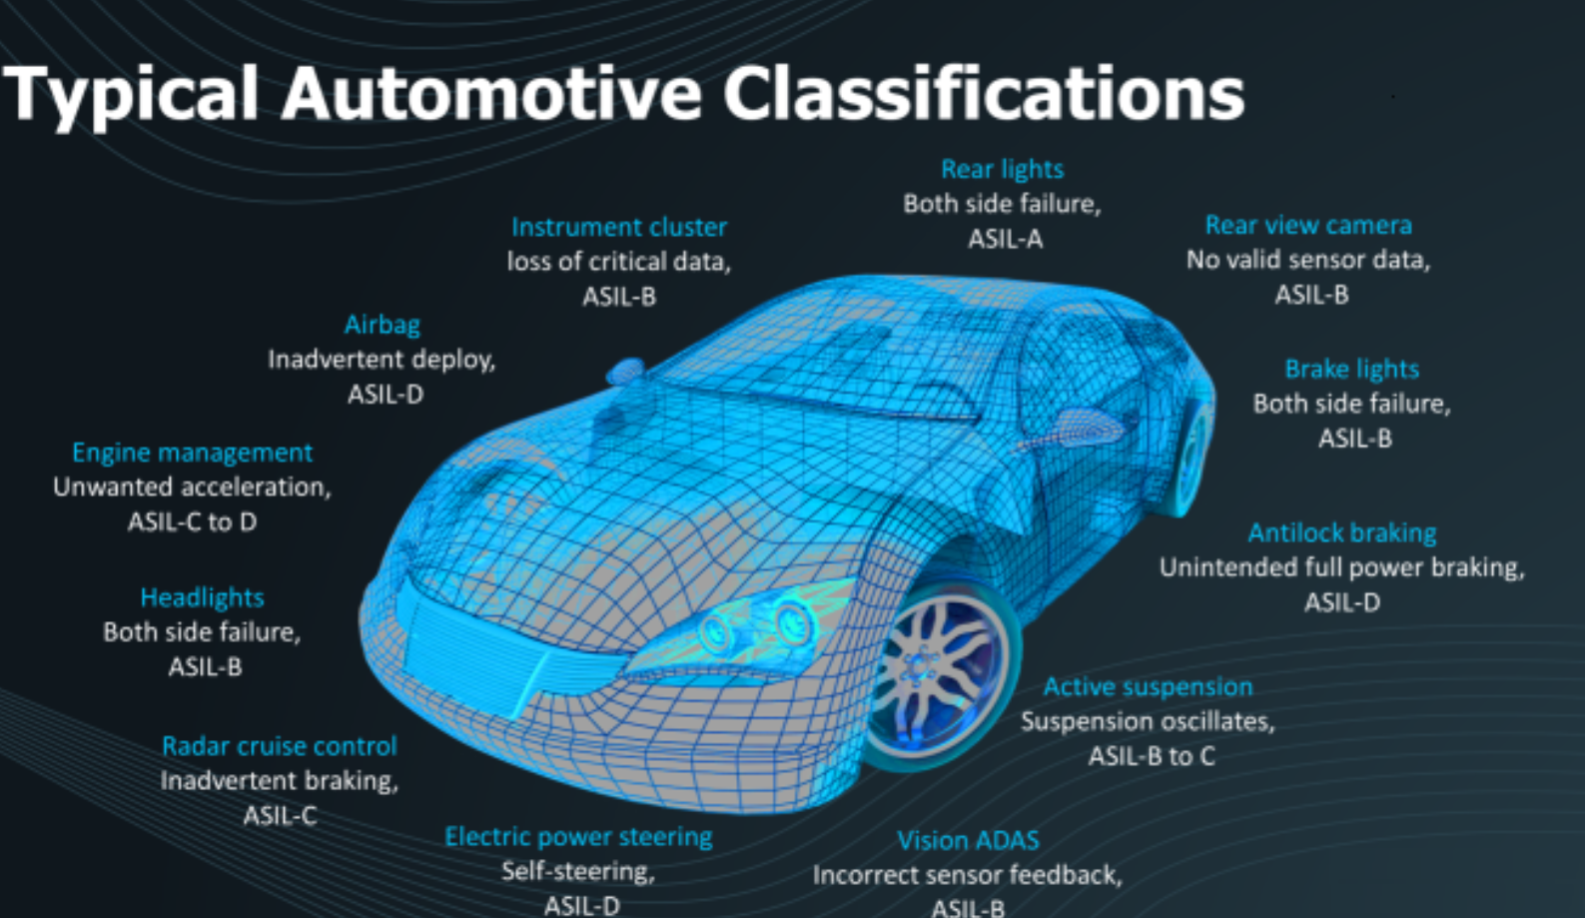

Slide 12

Steps
Definition of the system and its safety-criticality at the vehicular level.
Hazard Analysis and Risk Assessment ( HARA )
Determine Safety Goals for each component.

Slide 13
HARA
All scenarios of hazards or dangers evaluated for a particular component
Critical for vehicle safety

Slide 14

Safety Goals and Issues Types
The level of safety required by an automotive component to function normally without posing any threats to the vehicle.
Ex: during fire we want the door to open, but during high speed, we want it closed.

Slide 15
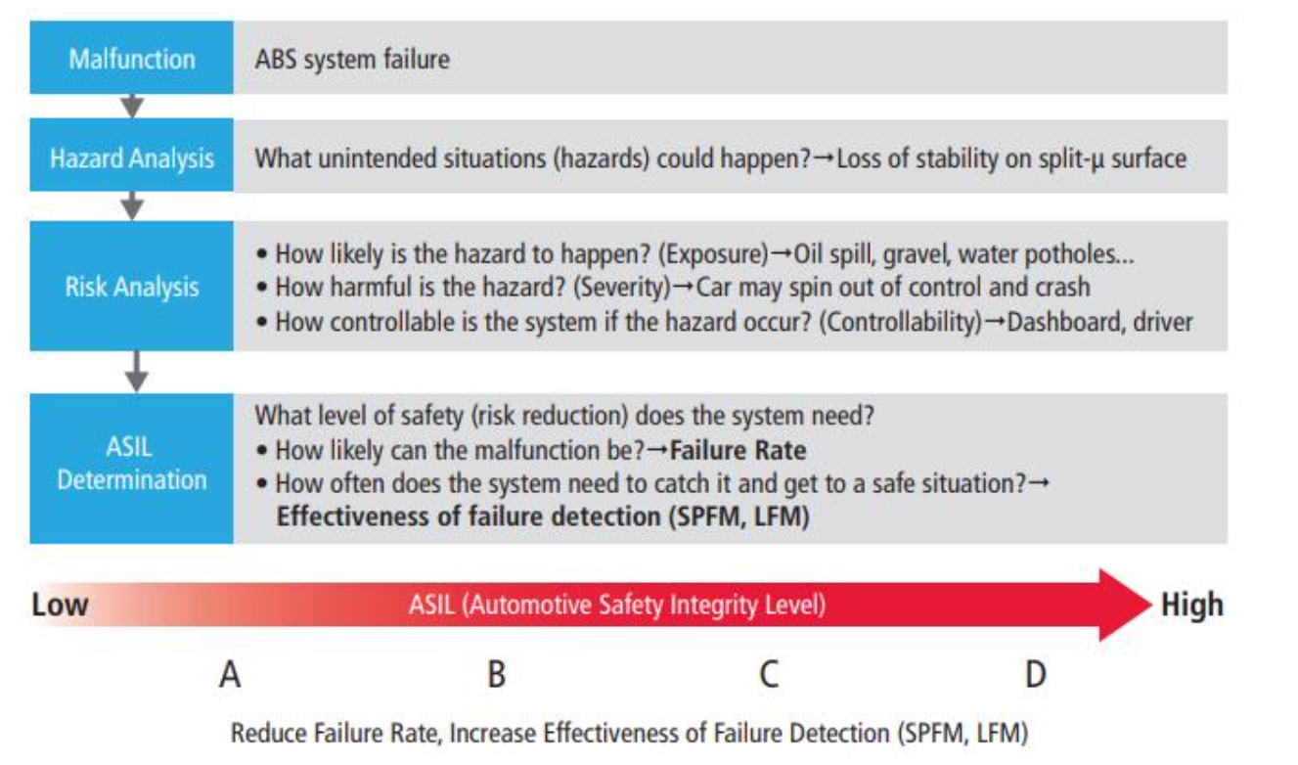
ASIL for ABS - Steps -

Slide 16
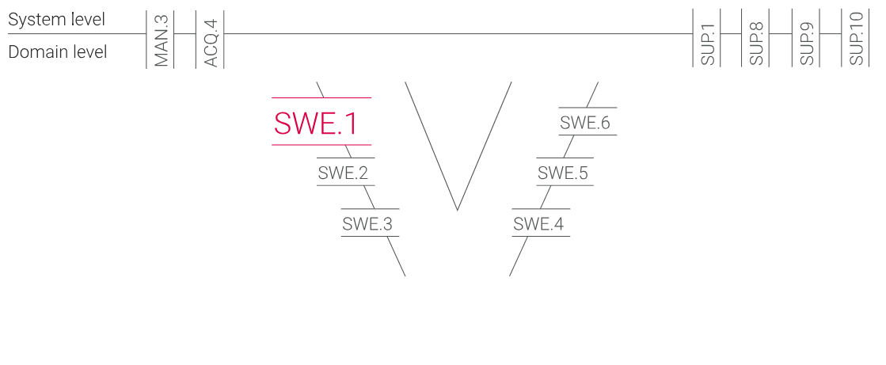
V-Cycle

Slide 17

Requirements analysis
Purpose :
Transform software related parts of the system requirements into a set of software requirements
Describe the WHAT
If the documentation of these requirements is not done, you might overlook or misinterpret customer's expectations which can result in additional costs, delays and effort.

Slide 18
Base practices ( SR )
Specify software requirements
Structure software requirements
Analyze software requirements: to ensure [correctness, technical feasibility, verifiability]
Analyze impact of operating environment.
Establish bidirectional traceability

Slide 19

System Requirements
Strong links to SYS.2, and SYS.3 ( upstream )
Strong links to SWE.2 ( architecture – downstream), and SWE.6
Automotive SPICE recommends :
Consider more than customer requirements
Regulation, standards, norms, internal requirements
Add stakeholder requirements
Describe the software as a black-box

Slide 20

Software Architectural Design
Purpose:
Defines how the functionality will be implemented
Describe the HOW

Slide 21

Software Architecture
Develop and Document
Allocate SR
Define interfaces
Behavior
Bidirectional traceability
Communicate the design
Define the right view
Document interfaces accurately
Ensure traceability

Slide 22
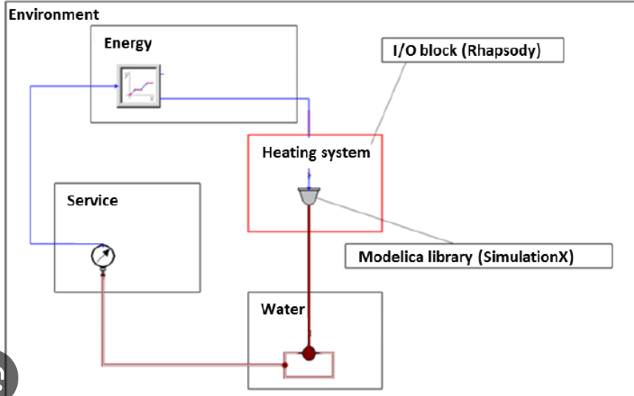
Software Architectural design
Components connected to each other and its shown how functions from either component is used by the other component and other relations
It is visible how each component interfaces with the other components
Traceability supports :
Consistency checks, impact assessment, reporting of stakeholder expectations

Slide 23

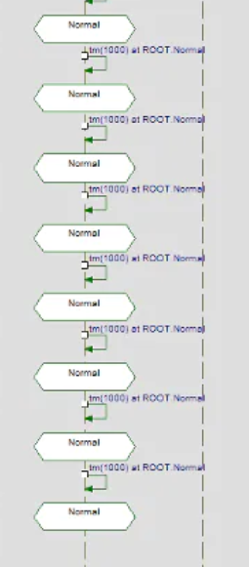
Detailed Design and Unit Construction
Purpose :
Basis of the implementation of the code and unit test

Slide 24

Detailed Design:
Develop detailed design
Define interfaces of SUs
Dynamic behavior
Evaluate design
Bidirectional Traceability
Communicate agreed software detailed design
Develop SUs
ISO 26262 provides guidance in safety critical software
Needs to contain :
Interfaces documentation
Names
Types
Units
Resolutions
! Should be written before code

Slide 25

Software Unit Verification
Purpose : Verify software units to provide evidence of compliance of SU with the software detailed design and non-functional SR

Slide 26
SWE.4 Unit Verification:
Define strategy for SU verification
Static and dynamic analysis
Code reviews
Unit tests
Regression test : make sure that anything that hasn't changed, still works well
Develop criteria for unit verification : MISRA ( standard to ensure code is safe, secure, reliable, portable )
Summary report

Slide 27

Software Integration and Integration Test
Purpose :
Integrate SUs into larger software items – consistent with architectural design
Ensure that software items are tested
Provide evidence for compliance of integrated SI with architectural design

Slide 28

SWE.5
Integration test strategy
Regression test strategy
Bidirectional Traceability
For each relevant architectural element, you can localize corresponding test
Consistency :
Links the subject to the correct test
Covers subject completely
No faulty tests
Summary report
Develop software integration strategy
Integrate SUs and SIs
Select test cases
Perform Software integration test
Establish BT
Ensure Consistency
Summarize and communicate results

Slide 29

Software Qualification test
Purpose : Ensure that the integrated software is tested to provide evidence for compliance with SR

Slide 30

Practices :
Check against the requirements
Close relationship with SWE.1
Clear test strategy
Test object
Test methods for test case development
Approach to test automation
Select right test cases
Traceability and consistency ( there are tools for this which also checks consistency)
Develop SQ test strategy and regression test strategy
Develop specification for SQT ( test cases, verification criteria etc.)
Select test cases
Test integrated software
Establish BT ( supports coverage, consistency and impact analysis ).
Ensure Consistency
Summarize and communicate results

Slide 31
Terms
Regression test : for retesting the integrated software if a SI (or component ) is changed
Integrated software : software that is implemented and working to some extend

